Slide 1
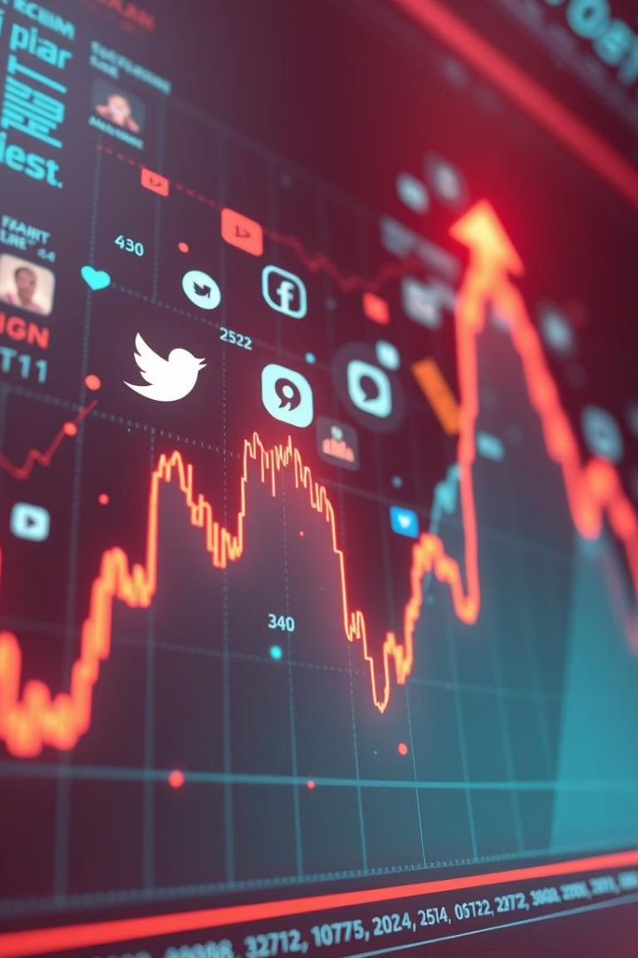

Predicting the Market with Sentiment Analysis
Harnessing public opinion for financial forecasting.
The market size was $1.4B in 2023, expected to reach $4.2B by 2032.
This is a data-driven approach to investment decisions.
by Sonu Kumar

Slide 2
Understanding Sentiment Analysis
NLP for Opinion Mining
Approaches
Natural Language Processing (NLP) is used for opinion mining.
There are lexicon-based and Machine Learning approaches.
It identifies positive, negative, and neutral sentiments.
Accuracy improves from 60% (lexicon) to 85% (ML).

Slide 3




Data Sources for Stock Market Sentiment
Social Media
News Articles
Company Reports
500M+ posts analyzed daily from Twitter, Reddit.
10,000+ news articles and financial blogs are used.
Company reports and earning call transcripts provide data.

Slide 4
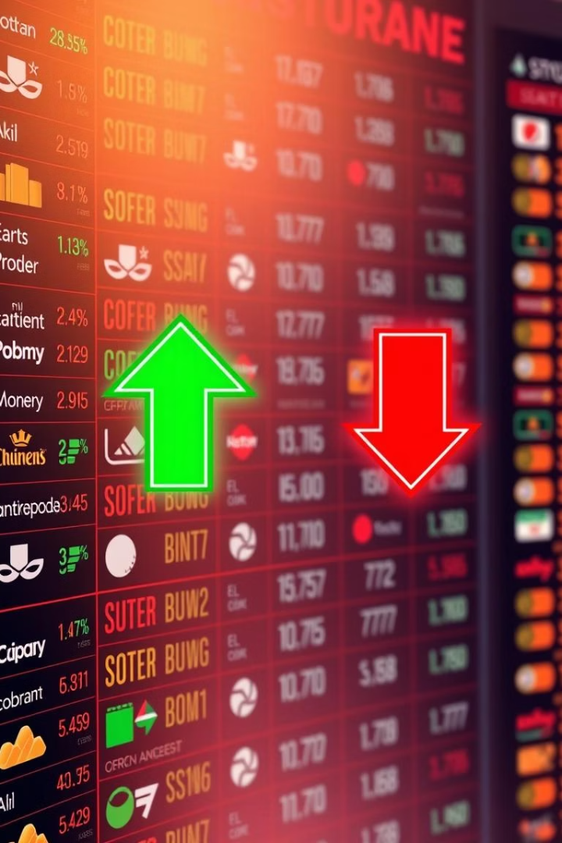
Key Sentiment Indicators
Sentiment Score
Volatility Index
Scale: -1 (negative) to +1 (positive).
Measures sentiment fluctuations.
Sentiment Divergence
Discrepancy between sentiment and price.

Slide 5





Building a Sentiment Analysis Model
Data Collection
Collect, clean, and preprocess data.
Feature Extraction
TF-IDF, word embeddings are extracted.
Model Training
Naive Bayes, SVM, LSTM are trained.
Backtesting
Test with historical stock data.

Slide 6
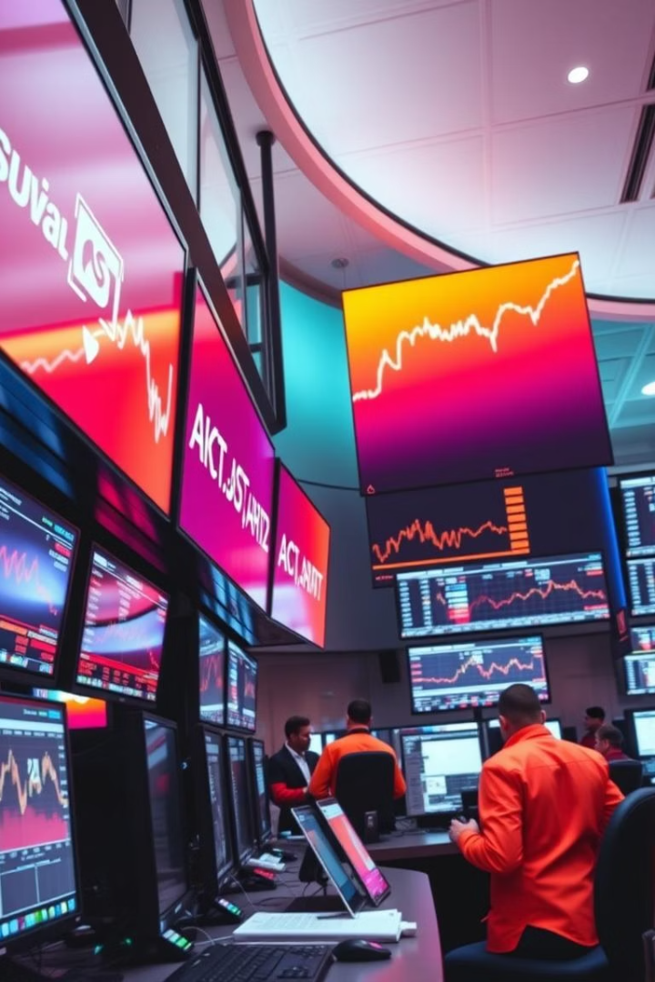
Sentiment-Driven Trading Strategies
Twitter Sentiment
News Sentiment
Stock price correlation: +0.65 for tech stocks.
Market volatility increased by 20% during crises.
Earnings Call
Earnings call sentiment impacts stock performance.

Slide 7
Challenges and Limitations
Data Bias
1
Data bias and noise exist in social media.
Sarcasm
2
Handling sarcasm and contextual nuances is hard.
Manipulation
3
Market manipulation is possible.

Slide 8



The Future of Sentiment Analysis in Finance
Real-Time Tracking
2
Real-time sentiment tracking.
Integration
1
Integration with AI and machine learning is growing.
Risk Management
Enhancing risk management and portfolio optimization.
3

